Slide 1

KultureHire Data Analytics Internship
Understanding Career Aspirations of Gen Z
By Gowri Prasanna Samantula

Slide 2
1
2
3
4
5
6
7
8
Problem Statement Documentation
Developed a problem statement to explore and educate about the career aspirations of Gen-Z, addressing challenges and personal insights.
Data Collection
Created a Google Form with tailored questions to collect data on Gen-Z's career aspirations.
Data Cleaning & Standardization
Loaded data dump into MySQL Workbench, cleaning and exploring high-level information using SQL basics.
Exploratory Data Analysis
Conducted data analysis using Excel and understood the characteristics of a dataset,identified the patterns and came to conclusions.
Data Analysis In SQL
Conducted data analysis using SQL, solving complex questions with the help of Common Table Expressions (CTEs) and joins.
Executive Dashboard In Excel
Created a Power BI dashboard summarizing Gen-Z's aspirations.
Functional Dashboards In Power Bi
Developed two focused dashboards for each area, incorporating KPIs, Power Query Editor, measures, and groups in Power BI.
Project Presentation
Worked on an employer-focused project, creating recommendations and emphasizing the importance of storytelling in data.

Slide 3
STAGE - 1 PROBLEM STATEMENT DOCUMENTATION

Slide 4
Gen Z feels ignored when chasing jobs they want, and employers struggle to hire or retain them.
WHO
WHEN
Who are Gen Z?
Individuals born between 1997 and 2012 (ages 13–28 as of 2025).
Represent ~30% of the global population and entering the workforce in large numbers.
Who are the employers hiring Gen Z?
Primarily tech companies, startups, creative industries, retail, and service sectors.
Companies like Google, Amazon, Deloitte, and Unilever are known to run specific Gen Z engagement and internship programs.
Who are not interested in hiring Gen Z?
Traditional industries (e.g., manufacturing, insurance, law) show hesitance due to perceived lack of work ethic or long-term commitment.
Small businesses lacking resources to adapt to Gen Z preferences or provide flexible work environments.
When will Gen Z be hired without struggle?
Likely when:
Education-industry alignment improves.
Employers adopt skills-first hiring and inclusive recruitment.
By 2027–2030, Gen Z will dominate the workforce (projected 30–35% by 2030).
When will employers hire Gen Z without hesitation?
As more Gen Z:
Build workplace skills.
Gain experience through internships/freelance/bootcamps.
Adjust expectations and show adaptability.

Slide 5
WHAT
WHERE
What are the main issues Gen Z face when finding a job?
Lack of work experience, soft skills, or practical exposure.
Over-dependence on online applications vs. networking.
Lack of clarity in career goals.
What are the reasons for not getting hired?
Employers cite issues such as:
Unrealistic expectations (salary, remote work, work-life balance).
Poor interview preparation or communication.
Lack of industry-specific skills.
What struggles do Gen Z face while getting a job?
Navigating digital-first hiring (e.g., ATS, video interviews).
Pressure of student loans and underpaid internships.
Mental health concerns and job rejection burnout.
What are the best jobs Gen Z enjoys?
Roles in:
Tech (e.g., software development, UI/UX design)
Digital marketing, content creation
Sustainability, social impact jobs
Freelancing and creator economy
Flexible roles with remote/hybrid options and meaningful work are most appealing.
Where did it start?
The struggle became pronounced post-2020 due to:
COVID-19 pandemic disrupting education and internships.
Shift to remote hiring processes.
Economic slowdown causing fewer entry-level roles.
Where can Gen Z be placed the most?
Tech hubs like San Francisco, Austin, Berlin, and Bangalore.
Remote-first companies and startups.
Industries like e-commerce, digital services, green energy, and AI-based platforms.

Slide 6
WHY
HOW
Why is Gen Z struggling to get a job?
Mismatch between academic training and job market demands.
Post-COVID economy led to reduced entry-level roles.
Over-saturation in certain degrees (e.g., communications, psychology) without complementary skills.
Why are employers finding it hard to manage Gen Z?
Gen Z demands feedback, transparency, purpose-driven culture, and flexibility.
High attrition and job-hopping tendencies.
Preference for mental health and work-life balance over traditional career ladders.
Why does Gen Z feel companies aren’t hiring them?
Perceived bias toward experience over potential.
Hiring processes are often lengthy, vague, and impersonal.
Lack of inclusive practices and Gen Z-oriented outreach.
How are leading companies successfully hiring Gen Z?
Creating youth-focused internship and graduate programs.
Emphasizing diversity, flexibility, and purpose in culture.
Using platforms like LinkedIn, Handshake, TikTok Careers.
Implementing skills-based hiring and fast-track interview processes.
How can job ads and interviews be adapted for Gen Z?
Use clear, jargon-free language.
Emphasize values, growth opportunities, remote flexibility.
Conduct transparent, shorter hiring timelines.
Incorporate video-based storytelling and social media recruitment.

Slide 7
DATA POINTS & TIMELINES
Metric / Event | Value / Date
Gen Z age range | 1997–2012
Gen Z % of workforce (projected by 2030) | ~35%
Peak Gen Z job entry years | 2020 - 2030
Top Gen Z priorities in jobs (LinkedIn 2024) | Flexibility (74%), Mental Health (65%)
Common reasons for rejection (Forbes 2023) | Poor communication (47%), No experience (34%)
% of companies facing Gen Z retention issues | ~58% (Deloitte Millennial Survey, 2024)

Slide 8
STAGE - 2 DATA COLLECTION

Slide 9
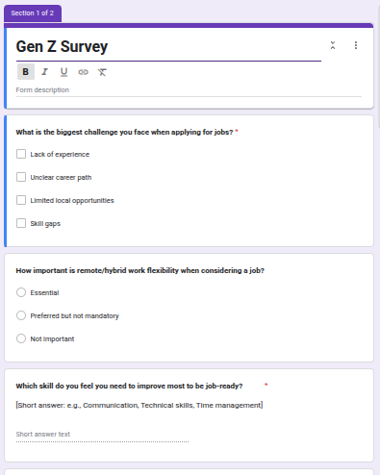
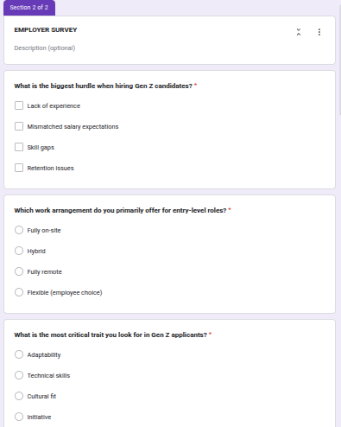

Slide 10
STAGE - 3 DATA CLEANING & STANDARDIZATION

Slide 11
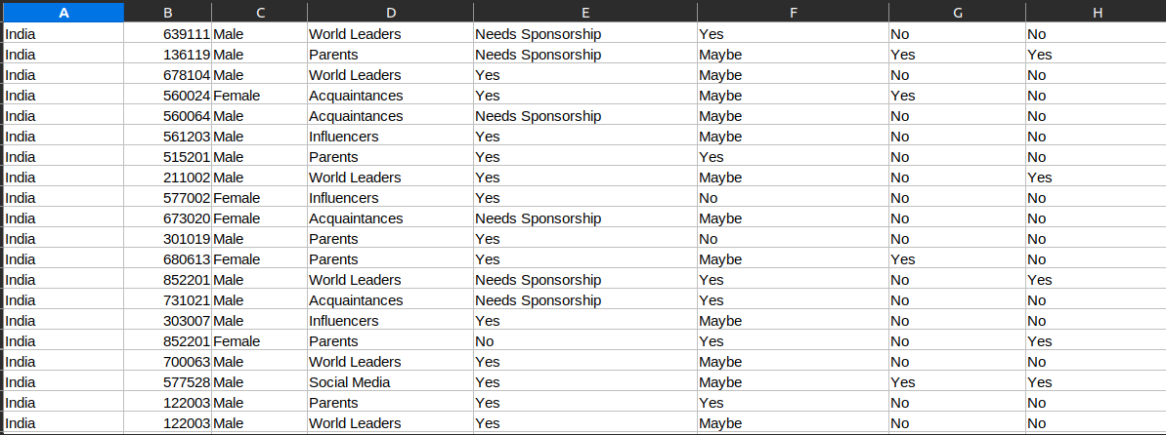

Slide 12
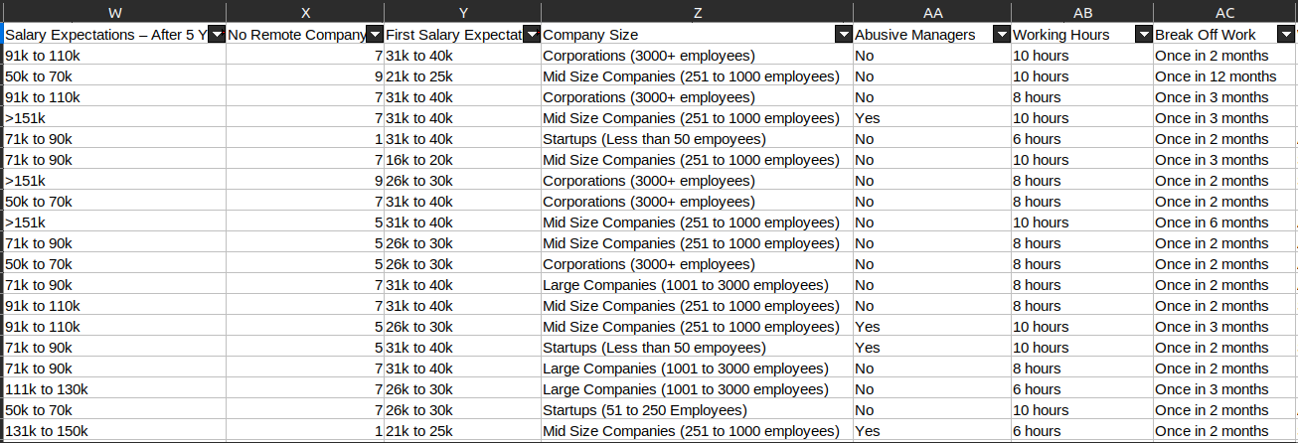

Slide 13
STAGE - 4 EXPLORATORY DATA ANALYSIS

Slide 14
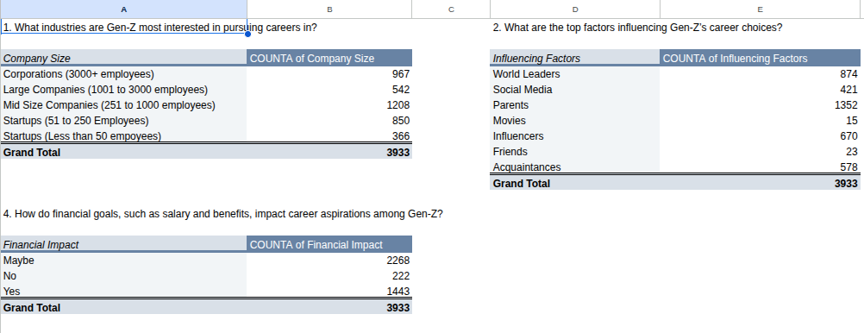

Slide 15
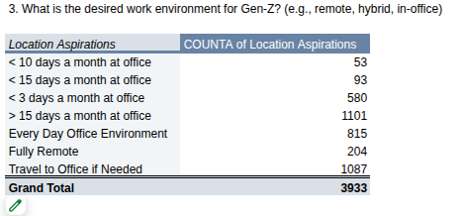
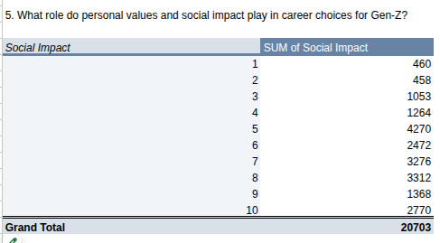

Slide 16
STAGE - 5 DATA ANALYSIS IN SQL

Slide 17
QUESTIONS
1. What industries are Gen-Z most interested in pursuing careers in?
2. What are the top factors influencing Gen-Z’s career choices?
3. What is the desired work environment for Gen-Z? (e.g., remote, hybrid, in-office)
4. How do financial goals, such as salary and benefits, impact career aspirations among Gen-Z?
5. What role do personal values and social impact play in career choices for Gen-Z?

Slide 18
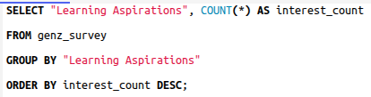
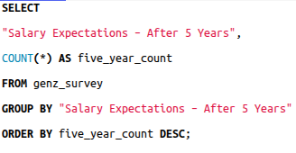
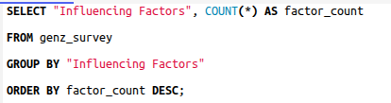
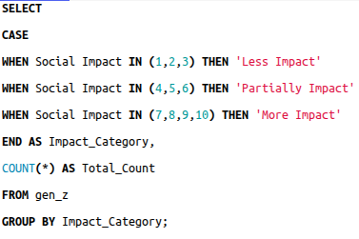
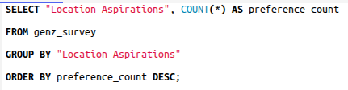

Slide 19
STAGE - 6 EXECUTIVE DASHBOARD IN EXCEL

Slide 20
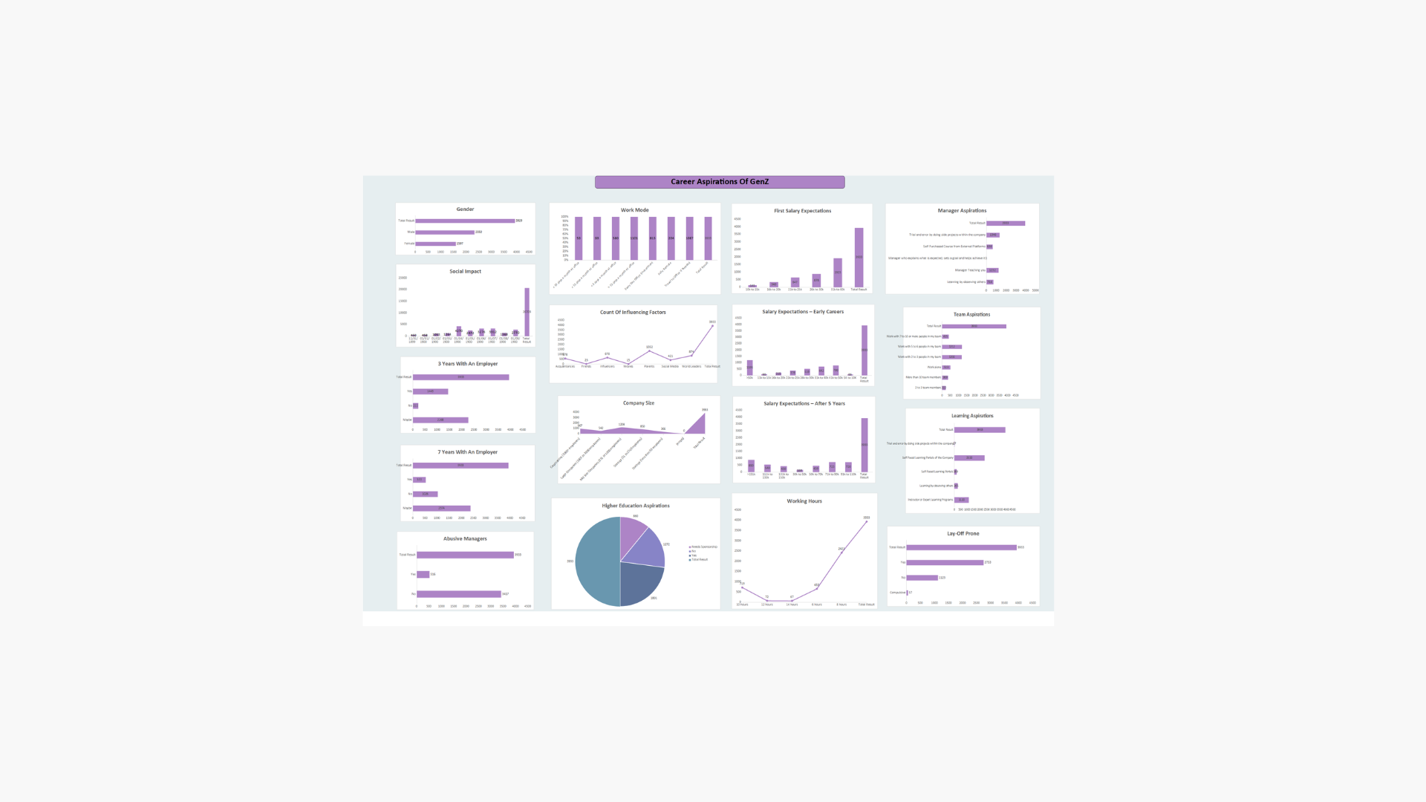

Slide 21
STAGE - 7 FUNCTIONAL DASHBOARDS IN POWER BI

Slide 22
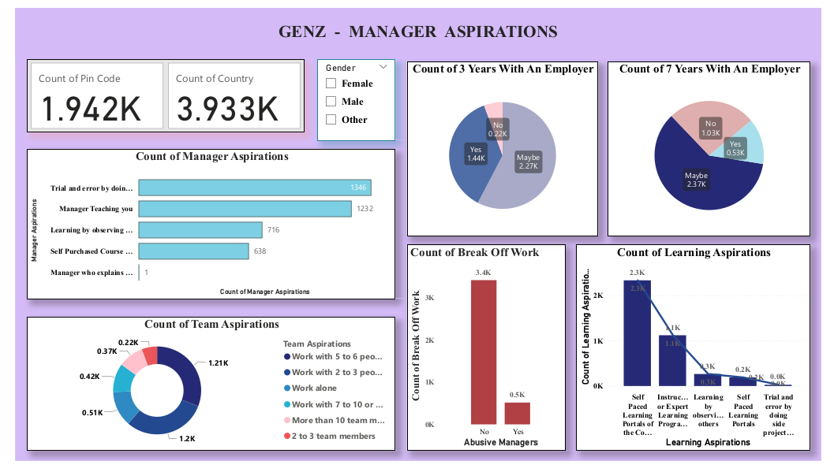

Slide 23
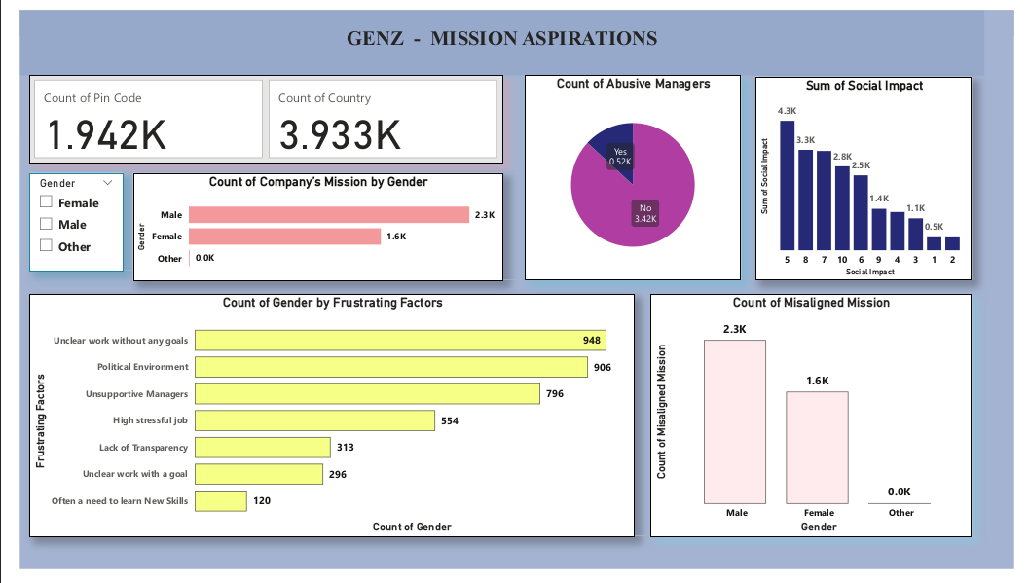

Slide 24
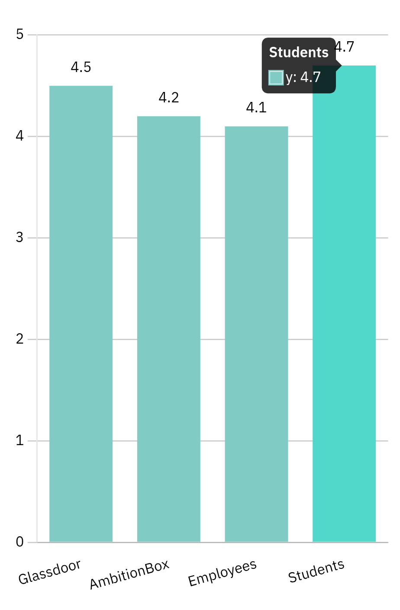
KULTUREHIRE has the most loyal mentors who try to support the best to the students

Slide 25
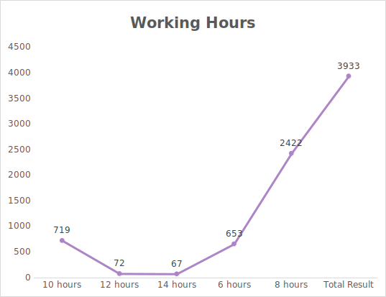
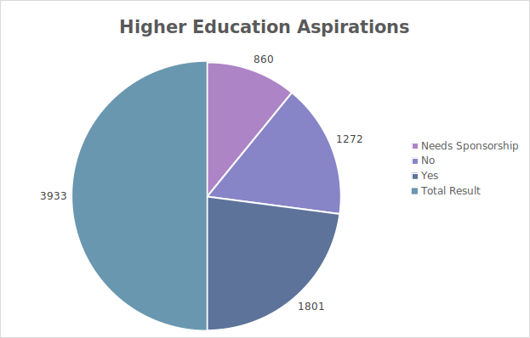

Slide 26
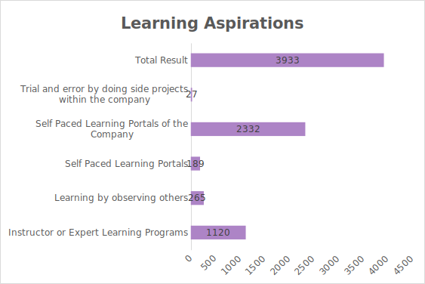

Slide 27
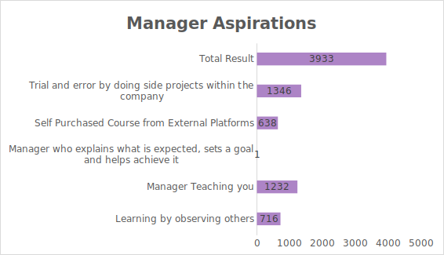

Slide 28
CONCLUSION
COMPANY NAME
THANK YOU
Any questions?

